Slide 1
Analysing the Social Network Structure
- Krishna Chaitanya Pappu
- Bakhtiyar Syed

Slide 2

OUTLINE
GOAL & MOTIVATION
Basics of Network Theory
Characterising Network Structures
Models
Tie Strength
Network Analysis through User Attributes & Behaviour
Propagation in Networks

Slide 3
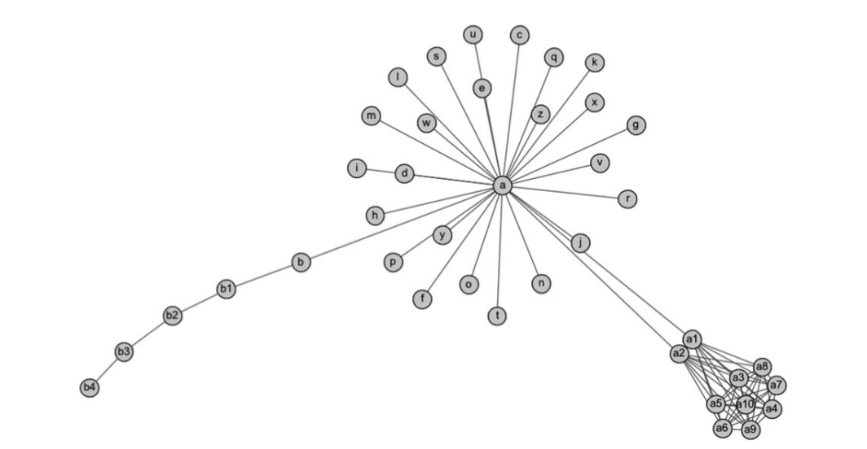
GOAL
Introduce techniques for analysing social relationships, among people or otherwise.
TERMINOLOGY
PEOPLE - Nodes RELATIONSHIPS - Edges

Slide 4
Motivation
WHY UNDERSTAND SOCIAL NETWORKS?
Organisations can control disease outbreaks.
Businesses can provide immediate assistance to people who have problems/complaints.
Content providers can show relevant content.
Understanding motivation behind contributing to Wikipedia, etc.

Slide 5
OUTLINE
GOAL & MOTIVATION ✓
Basics of Network Theory
Characterising Network Structures
Models
Tie Strength
Network Analysis through User Attributes & Behaviour
Propagation in Networks

Slide 6
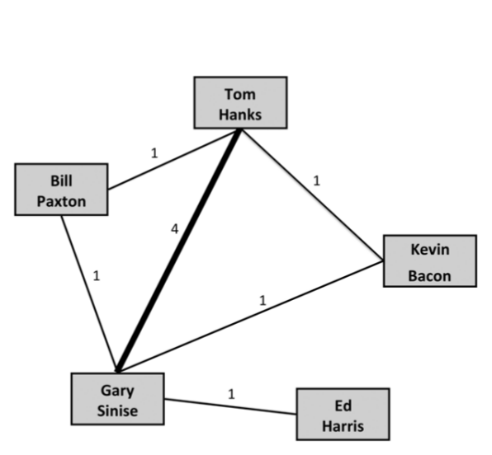
BASIC PROPERTIES OF NETWORKS
> Nodes - People/Actors
> Edges - Specific relationship (in this case, an edge denotes if 2 actors have acted in a movie together)
> Weights - How strong the relationship is.

Slide 7
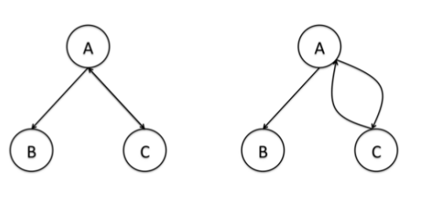
BASIC PROPERTIES OF NETWORKS
> Undirected Networks:
Indicate mutual relationships between the nodes. Eg. Actors in a movie
> Directed Networks:
Indicate one-sided relationships. Eg. Email communication

Slide 8
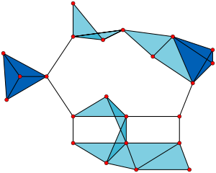
BASIC PROPERTIES OF NETWORKS
> Subnetwork Subset of the graph.
> Cliques Subnetworks whose each node is connected to every other within the subnetwork.

Slide 9
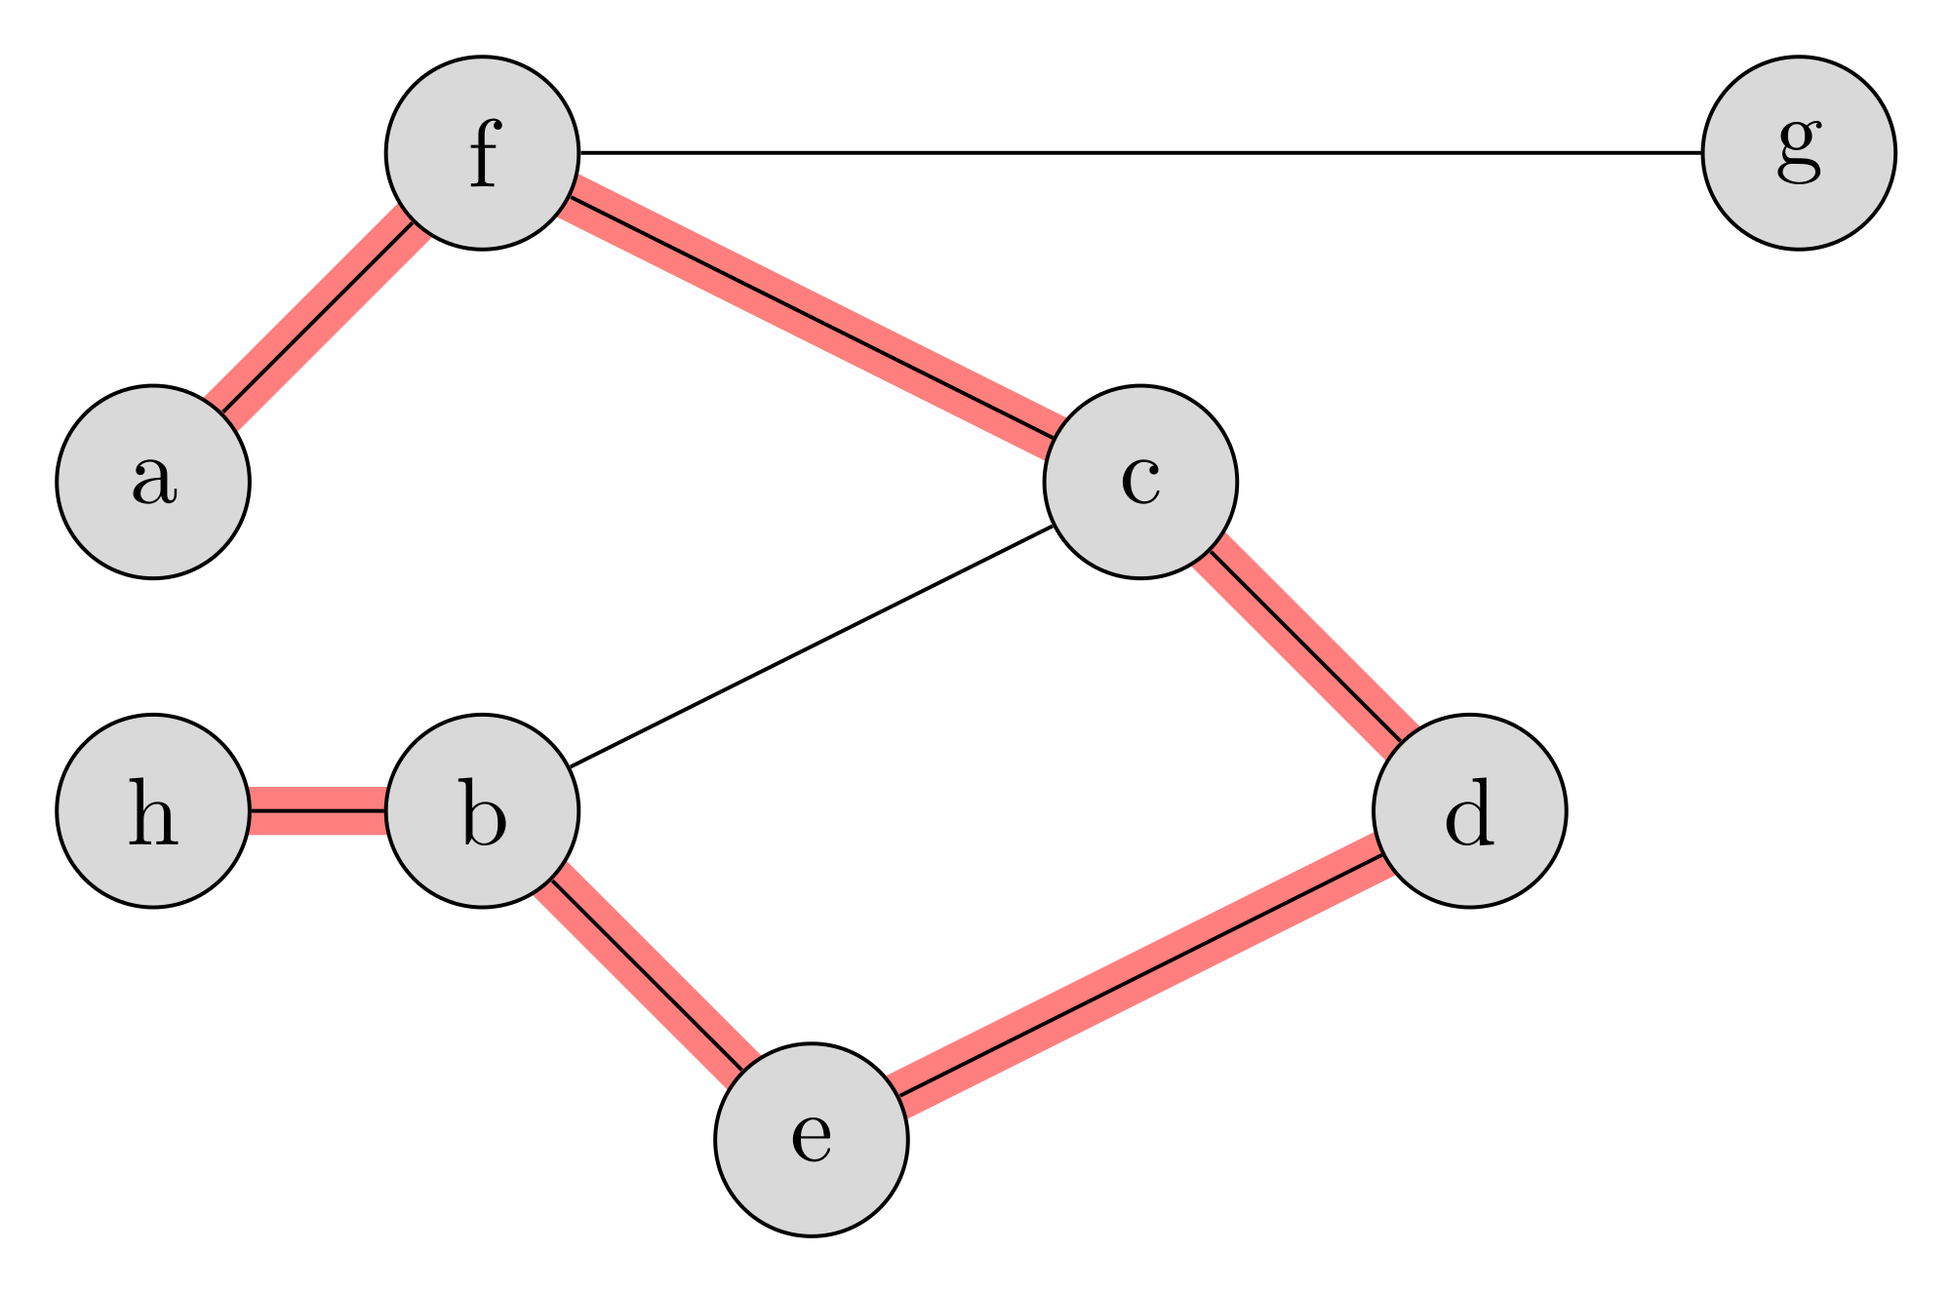
BASIC PROPERTIES OF NETWORKS
> Path Series of nodes traversed by following the edges.
> Connectedness 2 nodes in a graph are connected if there exists a path b/w them.

Slide 10
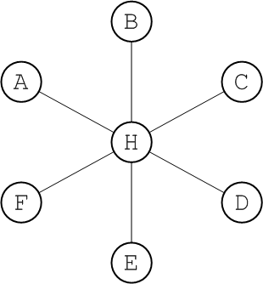
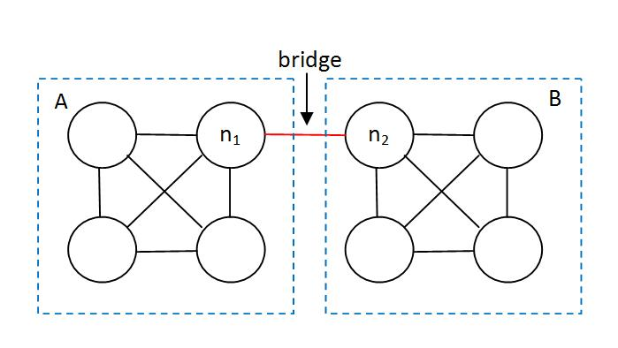
BASIC PROPERTIES OF NETWORKS
> Bridges Edge that connects 2 separate groups of nodes within a network.
> Hubs Most connected nodes in a network.

Slide 11
OUTLINE
GOAL & MOTIVATION ✓
Basics of Network Theory ✓
Models
Characterising Network Structures
Tie Strength
Network Analysis through User Attributes & Behaviour
Propagation in Networks

Slide 12
Models For Social Network Analysis

Slide 13
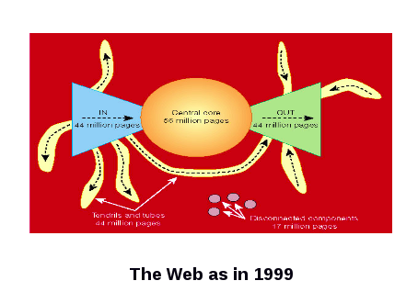
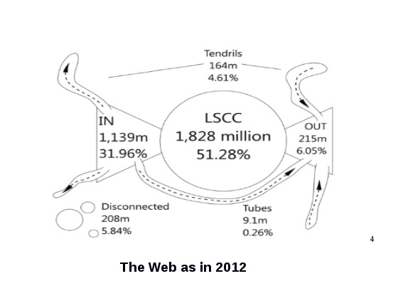
Bowtie Model
This model describes the nature of Web as a Bowtie.
Each node - Web page Each edge - Hyperlink.
A single large connected component is observed at the core and its In(V) and Out(V) together populate most of the other nodes.
Evolution :
The Central component increases.
Skewed Bowtie.
Tendrils, tubes become negligible.
Notes:
The images of Bowtie are one behind another just move the top image to see the other image.

Slide 14
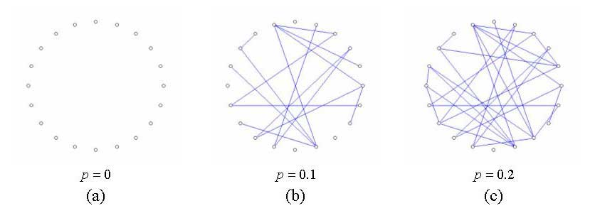
Erdos Renyi Random Model
Oldest proposed model.
It takes two input parameters n,p for generation.
n - The total number of nodes.
p - The independent probability of existence of each edge.
Not perfect, but can be used to know the extent of randomness in a real world data.

Slide 15
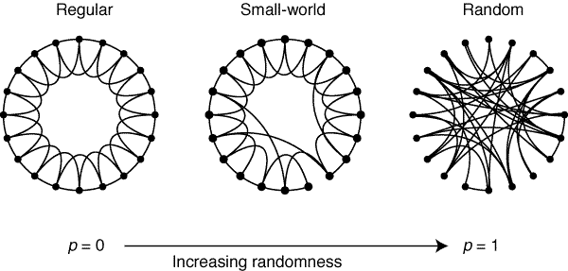
Small World Model
Concept : In the social network graph, any two nodes are closeby.
Starts off with a regular lattice. Adds randomness by shifting the ends of each edge to a random node with probability p.
Intermediate of regular lattice and random graph, thereby achieving low diameter and high clustering.

Slide 16
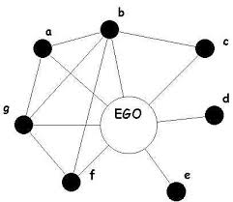
Ego Networks
Models the networks at an individual level.
Central node -‘Ego’ Immediate ties - ‘Alters’.
These nets give us a lot of information about Ego.
The power he/she enjoys
Diversity in contacts
Homophily - extent of similarity between Ego and his/her alters

Slide 17
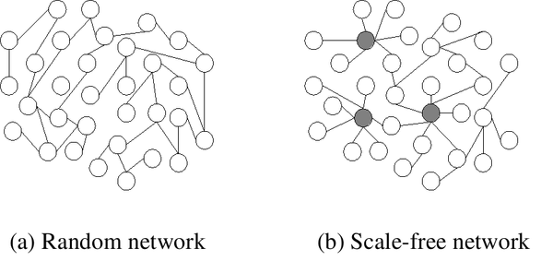
Scale Free
Follows a Power Law for node generation.
Random removal of even a large fraction of vertices impacts the overall connectedness of the network very little.
HUB formation results in robustness.

Slide 18
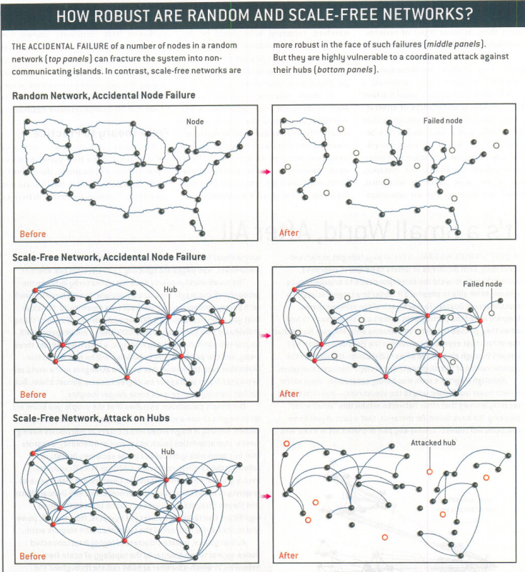
Robustness of Scale-Free Networks
Describing the robustness of scale-free networks in comparison to the Erdos-Renyi Random model.

Slide 19
How to generate Scale-Free Networks?

Slide 20
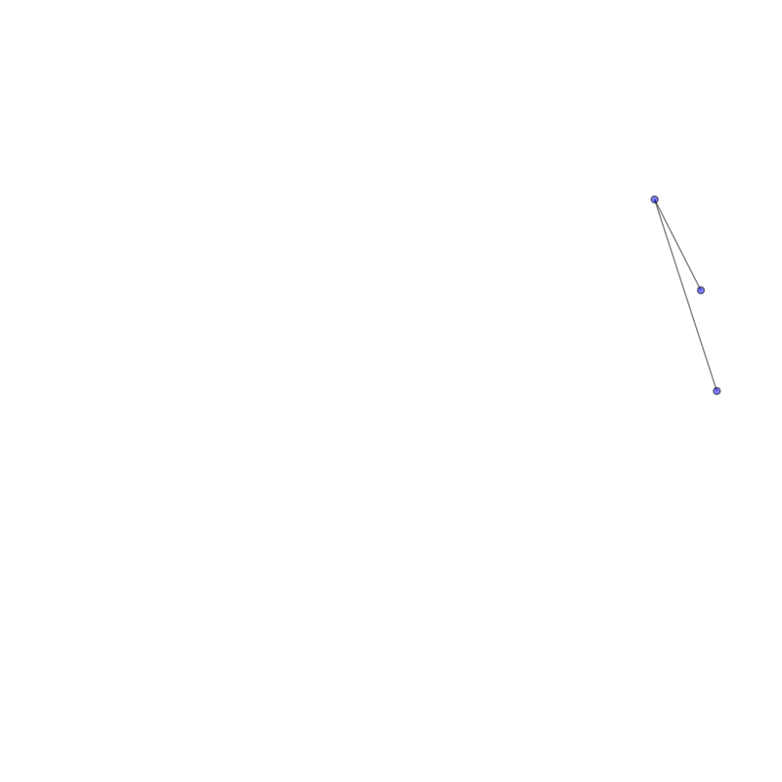
Generating via Barabasi-Albert Model
The network begins with an initial connected network of m₀ nodes.
New nodes are added to the network one at a time.
Each new node is connected to m < m₀ existing nodes with a probability that is proportional to the number of links that the existing nodes already have.
M₀ = 2.

Slide 21
OUTLINE
GOAL & MOTIVATION ✓
Basics of Network Theory ✓
Models ✓
Characterising Network Structures
Tie Strength
Network Analysis through User Attributes & Behaviour
Propagation in Networks

Slide 22
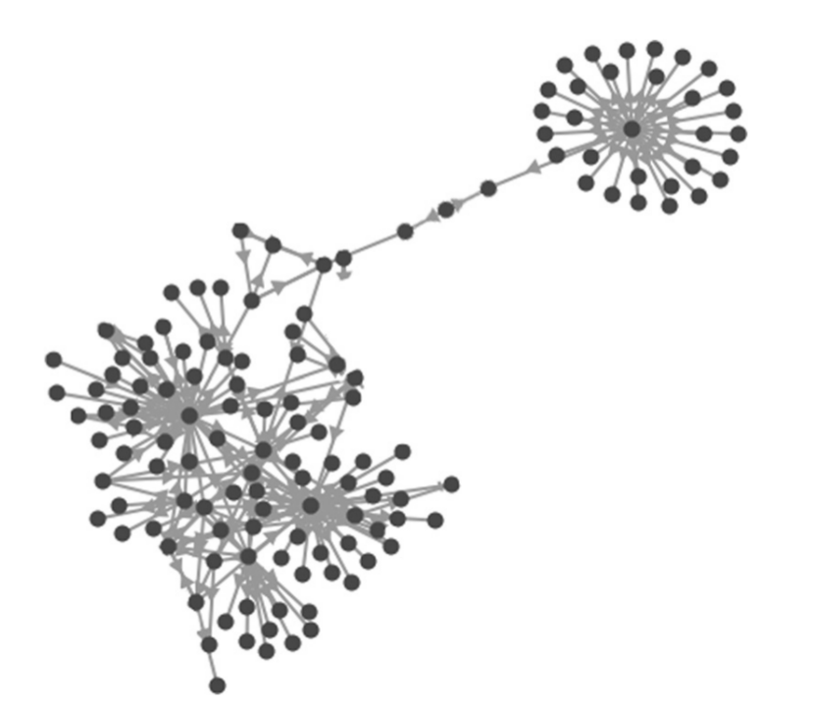
Characterising the Network Structure
CENTRALITY
> How “CENTRAL” a node is in the network.
> Many ways to define centrality.
> WE CONSIDER 4 TYPES:
- DEGREE CENTRALITY
- CLOSENESS CENTRALITY
- BETWEENNESS CENTRALITY
- EIGENVECTOR CENTRALITY
Notes:
Central may not always mean being in the center portion of the graph. Rather, it may specify influence or how important a particular node is to that network.

Slide 23
a. DEGREE CENTRALITY
b. CLOSENESS CENTRALITY
> It is simply the no. of edges a node has.
> Useful in assessing which nodes are central with respect to spreading information and influencing others in their immediate neighbourhood.
> Indicates how close a node is to other nodes.
> Computed by taking avg. of lengths of shortest paths to all other nodes.

Slide 24
c. BETWEENNESS CENTRALITY
d. EIGENVECTOR CENTRALITY
> Captures how important a node is in the flow of information from one part of the network to another.
> Useful in asserting how important a node is to the shortest paths through the network.
> Indicates the importance of a node while giving consideration to the importance of its neighbours.
> Main Principle: Links from imp. nodes are worth more than links from unimportant nodes.

Slide 25
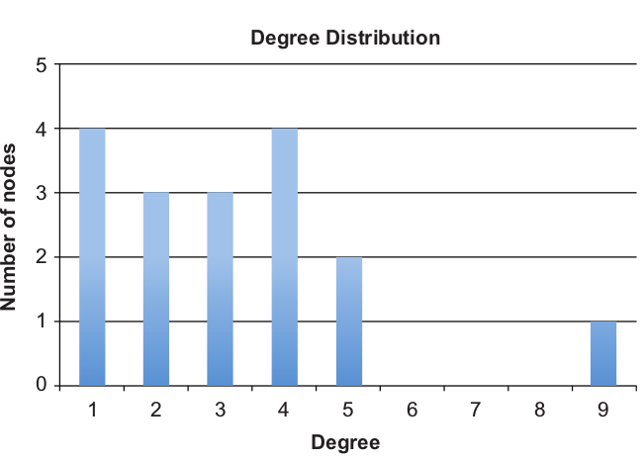
Characterising the Network Structure
2. DEGREE DISTRIBUTION
Shows how many nodes have each possible degree.
Useful for comparing 2 networks.

Slide 26
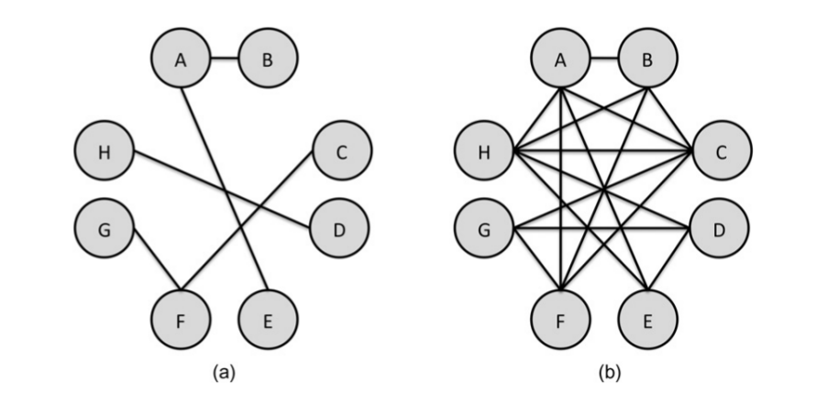
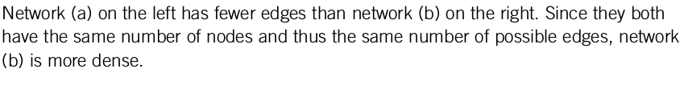
Characterising the Network Structure
3. DENSITY
> Describes how connected a network is.
> Density = No. of total edges / No. of possible edges

Slide 27
Characterising the Network Structure
3.a. DENSITY in EGO-CENTRIC NETWORKS
> Commonly used to compare subnetworks.
> Some nodes will have dense egocentric networks, which means a lot of their friends know one another.
> Others will have sparse networks, indicating that their connections do not know each other.

Slide 28
Characterising the Network Structure
4. CONNECTIVITY
Minimum no. of nodes that would have to be removed before the graph gets disconnected.
i.e. there is no longer a path from each node to every other node.

Slide 29
OUTLINE
GOAL & MOTIVATION ✓
Basics of Network Theory ✓
Models ✓
Characterising Network Structures ✓
Tie Strength
Network Analysis through User Attributes & Behaviour
Propagation in Networks

Slide 30
SOCIAL RELATIONSHIPS
They are complicated. Mostly depend on:
History
Similarity
Personal Background & Preferences
Environmental Factors

Slide 31
To measure social relationships, the concept of TIE STRENGTH was formulated by Mark Granovetter in 1973.
TIE STRENGTH
Measure of the strength of relationship between people.

Slide 32
STRONG TIES
WEAK TIES
They are rare. Usually,
Family members
Close friends
With whom one shares personal details
For whom the person will expect and do favours.
They are much more common.
Acquaintances
Casual friendship.

Slide 33
TIE STRENGTH
WEAK TIES
Aids in fast spreading of diseases.
May yet provide highly trusted info, eg. a physician.
Important but NOT the only factor which affects social network analysis.
The flow of information through a network relies on tie strengths.
STRONG TIES
Trusted networks.
Political influence/leanings.

Slide 34
ROLE OF TIE STRENGTH
Weak Ties play a significant role in how organizations and social groups function.
Granovetter in his paper “The Strength of Weak Ties” (1973) mentions how people got a job from relatively casual relationships (weak ties) and not strong ties.
People with Strong ties provide each other with access to food stamps, health care, money, social support.
Strong ties are important too. Committed, trustworthy, reliable.
Notes:
Read out 3 examples relating to tie strengths. Carl Y. was doing commission sales for an encyclopedia firm, but was not
doing well. He decided he would have to find a different job; meanwhile, he
started driving a cab to bring in extra money. One passenger asked to be taken
to the train station where he had to meet a friend. This friend turned out to be
an old friend of Carl Y’s, and asked him “what’re you doing driving a cab?”
When Mr. Y explained, the friend offered him the job he now holds—labor
relations manager for a small company, owned by his friend.
Granovetter, 1974, p. 34
George C. was working as a technician for an electrical firm, with a salary of
about $8000, and little apparent chance for advancement. While courting his
future wife, he met her downstairs neighbor, the manager of a candy shop, a
concession leased from a national chain. After they were married, Mr. C. contin-
ued to see him when visiting his mother-in-law. The neighbor finally talked him
into entering a trainee program for the chain, and arranged an interview for
him. Within three years, Mr. C was earning nearly $30,000 in this business.
Granovetter, 1974, p. 49
Edward A., during high school, went to a party given by a girl he knew. There,
he met her older sister’s boyfriend, who was ten years older than himself.
Three years later, when he had just gotten out of the service, he ran into him
in a local hangout. In conversation, the boyfriend mentioned to Mr. A. that his
company had an opening for a draftsman. Mr. A. applied for this job and was
hired.
Granovetter, 1974, p. 76

Slide 35
FACTORS INFLUENCING TIE STRENGTH
TIME.
EMOTIONAL INTENSITY.
INTIMACY.
RECIPROCAL SERVICES.
SOCIAL DISTANCE.
EMOTIONAL SUPPORT.
STRUCTURAL FEATURES LIKE MUTUAL FRIENDS.

Slide 36
How to measure these factors?
FACEBOOK DATA WAS COLLECTED IN GILBERT & KARAHALIOS’ WORK (2009)
SOCIAL DISTANCE
Age diff.
No. of educational degrees.
No. of occupations.
INTIMACY
No. of days since last communication
No. of mutual friends.
No. of intimate words in their fb convo.
INTENSITY
No. of words on each other’s walls.
Depth of email threads in their communications.
THIS METHOD WAS ACCURATE IN DETERMINING TIES TO WITHIN 10 % OF ACTUAL VALUE.
Notes:
Together, these variables were used to try to predict the tie strength of two
people’s relationship. They worked quite well—the researchers showed that when
users rated their tie strength on a scale, the automated method could predict it to
within around 10% of its actual value.
While Facebook offers a large dataset that can be measured for each aspect of
tie strength, Facebook-specific features will not be available in most contexts.
Determining tie strength by analyzing email communication, for example, will
differ from tie strength being inferred from a series of blog posts or by studying
interactions on a discussion forum. The seven factors above can serve as a guide-
line, but ultimately it is an understanding of the relationships and interactions in a
given context that will dictate how it can best be measured.

Slide 37
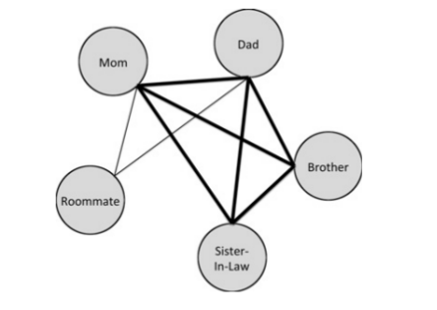
TIE STRENGTH
AND NETWORK STRUCTURE
Strong Ties appear in clusters.

Slide 38
TIE STRENGTH
AND NETWORK PROPAGATION
Gist: If we pass information to our strong ties and if they pass it to their strong ties, it will not go very far; instead, it is likely to reach people who have already received the message.

Slide 39
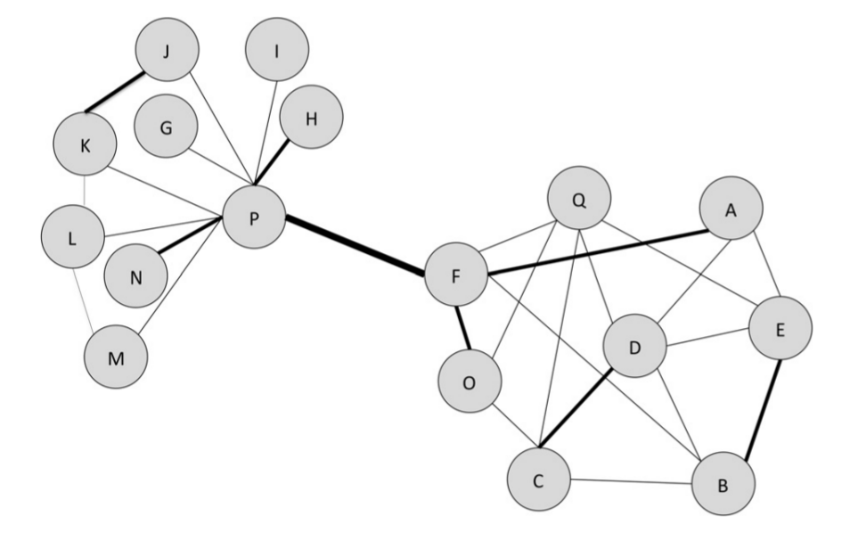
TIE STRENGTH
AND NETWORK PROPAGATION
Gist: Since there is usually smaller overlap in friends between a person and their weak ties, the weakly connected people have a chance to spread the
information to new people whom the source did not know.
Notes:
This is the effect Granovetter found in his study about finding jobs. Because a person has more weak ties than strong ties, and because the weak ties are connected
to diverse social groups that the person would not otherwise communicate with, the weak ties are more often sources of new information, like job opportunities.
Weak ties are powerful in helping spread information farther through a network, but this is not to say that strong ties are unimportant. Strong ties tend to be more trustworthy, reliable, and personal. A weak tie may be able to tell a person
about many job opportunities, but a strong tie will have a better idea of what jobs
would be a good fit. Strong ties are also more likely to do things to help one
another (i.e., reciprocal services).

Slide 40
OUTLINE
GOAL & MOTIVATION ✓
Basics of Network Theory ✓
Models ✓
Characterising Network Structures ✓
Tie Strength ✓
Network Analysis through User Attributes & Behaviour
Propagation in Networks

Slide 41
Understanding Network Structure through User Attributes, Behaviour and Content

Slide 42
Introduction
Attributes - Age, gender, location etc.
Behaviour - Actions taken by nodes.
How frequently the user posts.
How many friends/followers/following
How many times user reacts to shared content etc.
Content - It is the type of things the user posts and talks about with his/her friends.

Slide 43
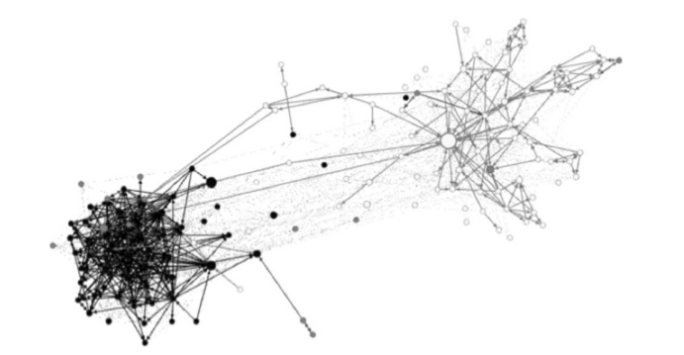
An example showing its importance
Just looking at the graph, we see that there are two clusters but no idea as to why they are so.
Color Coding
Black - Posts mostly in Spanish
White - Posts only in English
Gray - Multiple languages
Now we have a clear idea of this clustering only because of analysing the attribute Primary Language.
EGO NETWORK OF A TWITTER USER
Notes:
Some nodes like singleton nodes in a social network may describe users who join a social networking site and leave, thereby resulting in the creation of such nodes.

Slide 44
How to Analyse based on attributes and behaviour?
Base analysis on Structure.
Identify clusters/isolated nodes.
Pick up nodes from different clusters and also same clusters.
Try to find a common attribute/behaviour and color the graph with it.
See the network and whether it justifies the clustering/isolated nodes.

Slide 45
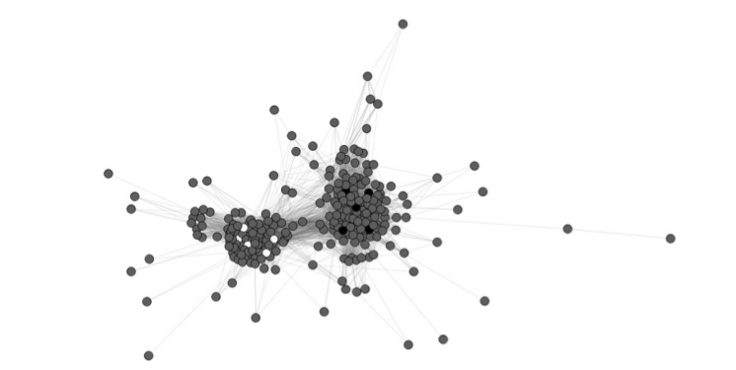
Cub Example
A graph of youtube videos that have the tag ‘cub’.
We clearly see two clusters.
Now we randomly pick some nodes from the left and right clusters and analyse them.

Slide 46
Conclusion:
Hand in Hand
Left clusters : Videos related to Chicago Cubs. Right ones : About animals.
Further within clusters again we can have structural analysis about density and how many nodes have the keywords etc.
These both work hand in hand to extract information.

Slide 47
OUTLINE
GOAL & MOTIVATION ✓
Basics of Network Theory ✓
Models ✓
Characterising Network Structures ✓
Tie Strength ✓
Network Analysis through User Attributes & Behaviour ✓
Propagation in Networks

Slide 48
Propagation In Networks

Slide 49
Epidemic Models
More of a classification model, rather than propagation.
Classifies nodes in one of the three categories.
S - Susceptible to disease.
I - Infected with disease.
R - Recovered from the disease.
A model which describes disease patterns.

Slide 50
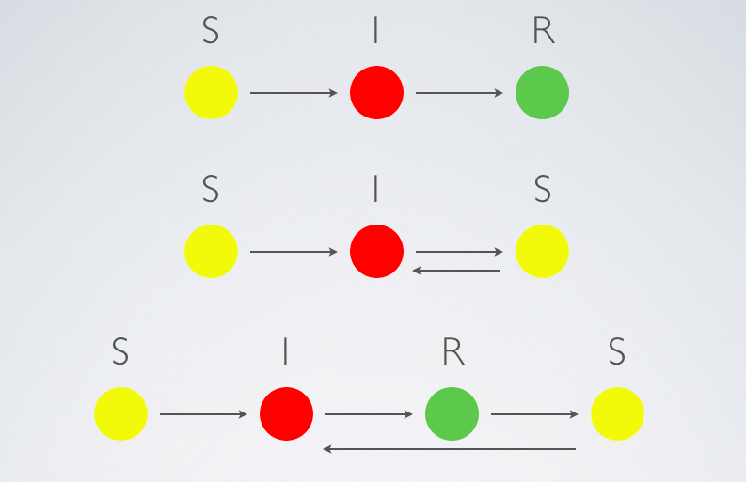
Epidemic Model
Furthermore it classifies the diseases as SI,SIR,SIRS,SIS.
The idea can be applied to Social media.
We can classify the nodes for a particular propagation.
Also we can classify the item propagating as SI/SIR/SIRS,SIS.

Slide 51
Threshold Model
It considers flow of the disease through immediate neighbours.
In a k-threshold model, a node’s k immediate neighbours should be infected and should propagate for the node to get infected.
In this way we update the infected nodes based on neighbors at each timestamp.

Slide 52
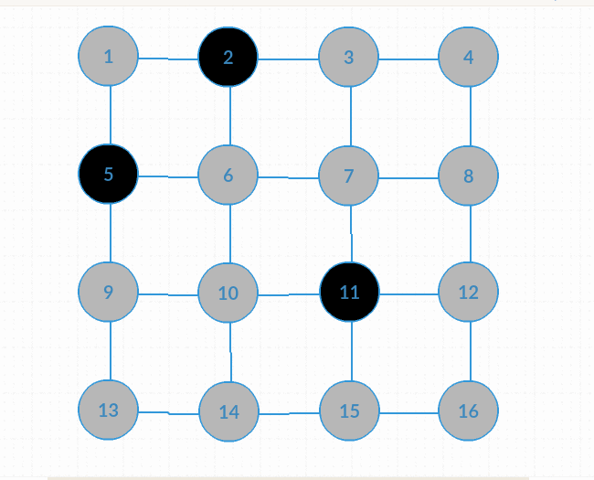
A dynamic propagation
This is 1-threshold propagation.
It ends up infecting all the nodes.

Slide 53
A dynamic propagation
This is 2-threshold propagation.
It gets saturated after 4 steps.

Slide 54
Stochastic Model
The models we discussed till now consider a deterministic infection and propagation.
This model considers probabilities
Probability of Propagation - Given a node has disease with this probability, its neighbours get infected.
Probability Of Infection - With what probability a node carries disease.
Probabilities are induced.

Slide 55
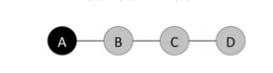
Basic Example
p(P) = 0.8
Node A is infected with P(I) = 1.
Considering 1-threshold propagation
p(I)_{B} = p(I)_{A}*p(P) = 1*0.8 = 0.8
p(I)_{C} = p(I)_{B}*p(P) = 0.8*0.8 = 0.64
p(I)_{D} = p(I)_{C}*p(P) = 0.64*0.8 = 0.512
p(P) is Probability of Propagation.
P(I) is Probability of Infection.

Slide 56
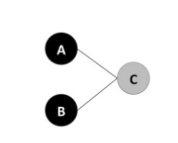
Example
p(P) = 0.6
We start of f with two p(I)=1 infected nodes A,B.
Considering 1-propagation and 2-propagation get the probabilities of P(I)_{C}.
1 - propagation P(I)_{C} = 0.84
2- propagation P(I)_{C} = 0.36
Notes:
In the
1-threshold case,
Either A propagates or B propagates or both propagate sum all cases.
P(I)_{C} = 0.6*0.6 + 0.4*0.6 + 0.6*.4 = 0.84.
2-threshold case,
Basically both have to propagate.
P(I)_{C} = 0.6*0.6 = 0.36

Slide 57
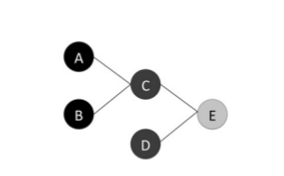
A small extension
Add D,E where E is not infected initially.
P(I)_{D} = 0.7
Analyse both the 1-propagation and 2-propagation chances of Infection.
1-threshold : Consider all cases.
2-threshold: Both are infected and both pass the disease is the only case E is infected.
Notes:
In the 2-threshold case,
P(I)_{C} = 0.6*0.6 = 0.36 as both A and B have to transmit.
Then P(I)_{E} = P(I)_{C}*P(I)_{D}*P(p)*P(p) = 0.36*0.7*0.6*0.6 = 0.09072.
In 1-threshold case,
3 cases
C and D are both infected and (C and D both pass it or Only C passes it or Only D passes it). 0.7*0.84(0.6*0.6 + 0.4*0.6 + 0.6*0.4) = 0.588*0.84 = 0.494
C is infected, D is not infected and C propagates . 0.84*0.3*0.6 = 0.151
D is infected, C is not and D propagates. 0.7*0.16*0.6 = 0.067
Total being = 0.494 + 0.151 + 0.067 = 0.712.

Slide 58
FireFighter - An interesting problem

Slide 59
Firefighter Problem
Firefighter - Immunity provided to the node on account of which the node is protected from infection.
We can formulate interesting problems with k-threshold disease propagation and n-firefighter paradigm.

Slide 60
FireFighter Problem
At t=0 we have a set of infected nodes.
Depending on the k (threshold ) the disease propagates.
In the next time stamp we can place n firefighters, basically we can protect n-nodes.
This process keeps happening alternatingly till all nodes are infected or propagation stops.

Slide 61
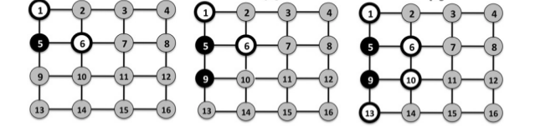
How propagation was successfully stopped in a 2-firefighter and 1-threshold propagation.
The selection of nodes is very crucial for saving maximum number of nodes.
Notes:
At alternate timestamps propagation and firefighter placement happens.
At t=0 node 5 is infected.
At t=1 we place 2 firefighters at 1,6 as it is 2-firefighter problem , at each step we place 2 of them.
At t=2 the infection propagation happens to 9 as it is only unprotected neighbour.
At t=3 we place further 2 firefighters at 10,13 and thereby block the spread of disease further,

Slide 62
OUTLINE
GOAL & MOTIVATION ✓
Basics of Network Theory ✓
Models ✓
Characterising Network Structures ✓
Tie Strength ✓
Network Analysis through User Attributes & Behaviour ✓
Propagation in Networks ✓

